Slide 1

LANGUAGE LEARNING APP FOR DIFFERENTLY ABLED PERSON
(WITH FACILE-BRAILLE KEYBOARD)
GUIDE NAME : Dr.Mrs.B. ANNI PRINCY
Professor
S.AMRITHA (211414205006)
S.NIRAJA (211414205065)
R.DARSHINI (211414205021)

Slide 2
ABSTRACT
Initially the app will prompt the user to select how he is differently abled (deaf or blind)
Now based on the option selected for blind people the entire UI will be converted into voice recognition system and text to Speech
Hence the user can orally listen and learn and to learn to write, a special interface called Braille Keyboard is used
If the user is deaf , The UI will become touch based .
Now the user will start learning visually and he will understand the words through American Sign Language

Slide 3
EXISTING SYSTEM
For Blind People
JAWS SOFTWARE
Compatible with Windows 8
Text analyzing tools for identification of errors and proof reading/ formatting of document by the blind/ visually challenged
OCR facility to read PDF and Scanned Graphics having embedded text
Enables blind to fill electronic forms in web pages
Facility to add Indian words to in-built dictionary of the software for accurate pronunciation

Slide 4
.
Graphic labeller feature enabling the blind to give text labels to Icons, Menus, and Links etc. for better accessibility by the blind in any special Windows Applications
Script Manager Feature for creation of scripts for accessibility by the blind for special Windows based applications not otherwise accessible.
FOR DEAF PEOPLE
‘Let Me Hear Again’ helps differently abled users, who are hard of hearing or deaf, communicate with others who do not know the American Sign Language
FEATURES OF THIS APP
Face to face chat Quake wake alarm
Virtual notes Guardian Angle
Call companion

Slide 5
PROPOSED SYSTEM
1. The first page is a registration form where the User Name And how he is Differently Abled
Blind
Deaf
For BLIND
If the user is blind the App should work only through voice input
It involves Text to Speech and voice input from user
3. The Next page will ask the user to choose the language he wants to learn .
English
French
German
4. Upon getting the voice input from the user ,the next page containing the respective lessons for that language will open

Slide 6
.
5. Every language will have Four –Five Lessons
The lessons will contain the basic alphabets and the Braille code for those alphabets
6. In every lesson the user will be given the privilege to “Replay or Previous or Next “
7. After completing each lesson the user must be tested by asking him to write the Braille code for the alphabet
For DEAF
1.The user will be taught the basic Alphabets along with their signs
2. The sign used is based on American Sign Language (ASL) which is a standard form used by deaf students in their learning process
3.Even here the alphabets will be split into four lessons
4. After completing each lesson a test will be conducted
5.By this App the user can learn a language in a easy and convinient manner

Slide 7
SOFTWARE & HARDWARE REQUIREMENTS
HARDWARE REQUIREMENTS
PROCESSOR : core i5
MOTHERBOARD : Genuine Intel
MICRO CONTROLLER : Arduino UNO
RAM : Minimum 4 GB
HARD DISK : 1 TB
SOFTWARE REQUIREMENTS
OPERATING SYSTEM : Windows OS 8.1
TECHNOLOGY USED : Java
IDE : Android Eclipse,Arduino
DATABASE : MySQL
TOOLS USED : NetBeans ,SQLYog, Eclipse ,JDK 1.8

Slide 8

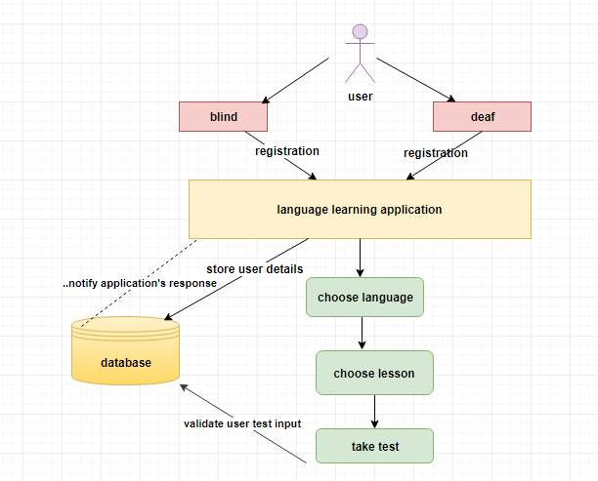
Architecture diagram

Slide 9
FLOW DIAGRAM
ONE TIME REGISTRATION
SELECT LANGUAGE
SELECT LESSON
.
1.BLIND
2. DEAF
1.ENGLISH
2.GERMAN
3. FRENCH
1. LESSON 1
2. LESSON 2
3. LESSON 3
4. LESSON 4
5. LESSON 5
TAKE TEST

Slide 10
NOVELTY
The main novelty of our project is that we have used a Braille keyboard developed by us which is interfaced with the Mobile Application . The Application will ask the user to enter the Braille code for any particular alphabet .Once the user enters the code through the Braille keyboard ,it will be stored in the web service and through JDBC connectivity it gets updated to the backend database . The Application then verifies the codes and prompts the user whether the answer is correct or not
CLAIM 1
Unique Feature : BRAILLE KEYBOARD AND ANDROID APPLICATION INTERFACING
Description : A Braille keyboard is used which gets the input from the user and stores it in a backend database .The Application then verifies the code and tells the user whether his/her answer is correct or not .If the answer is correct the page moves to the next question

Slide 11
MODULES SPLIT UP
1. UNIQUE REGISTRATION AND LOGIN
2. LANGUAGE SELECTION
3. LEARNING LESSONS
4. BLIND (TEST)
5. AMERICAN SIGN LANGUAGE (ASL)
6. LEARNING LESSONS
7. DEAF (TEST)

Slide 12
MODULES DESCRIPTION
1 UNIQUE REGISTRATION AND LOGIN
The Blind and deaf people will be asked to enter their name through voice input for blind people and through normal keyboard typing for deaf .Next the type of disability (Blind or Deaf ) should be mentioned .All the details entered will be stored in a database .
INPUT :Username and type (blind / deaf)
OUTPUT: Connected to database and moves to second module
2 LANGUAGE SELECTION
If the Type is Blind, the next page will ask the user to select the language they want to learn .There are three options available namely English French and German
Every Language will be split into four–five lessons and the user can navigate through each lesson using “next” and “previous” keywords

Slide 13
.
INPUT :The desired language (Voice input)
OUTPUT: Connected to database and moves to third module
3 LEARNING LESSONS
Every language will have four-five lessons and each lesson will contain 6 alphabets along with their Braille codes .Every alphabet can be played any number of times according to the grasping power of the user
At the end of every lesson a quick revision will be available to have a quick glance of everything seen in that lesson so far.
INPUT :The lesson number is given as input (voice input)
OUTPUT: The app moves to the fourth module
4 BLIND (TEST)
This is the main novelty of our project .In this module the user will be tested on whatever they learnt in the lesson so far .

Slide 14
.
The app will ask the user to enter the Braille code for any alphabet (from the list they learnt )
The input will be given through the Braille Keyboard .The user will enter the code through the Braille keyboard which will be verified by the app and say whether it is correct or not .
INPUT :The Braille code through the Braille keyboard
OUTPUT: It prompts the user whether the input is correct or not
5 AMERICAN SIGN LANGUAGE (ASL)
If the user type is deaf, the next page will have a small introduction about ASL which is widely used by hearing impaired people to learn a new language.
From here the user can navigate through normal buttons
INPUT :Username and Type(deaf)
OUTPUT: Stored in the database and moves to next module

Slide 15
.
6 LEARNING LESSONS
The next page will contain the alphabets split into four lessons Each lesson will have 8 alphabets along with their signs .At the end of every lesson a test will be conducted to the user
INPUT :Select the lesson (touch input)
OUTPUT: Moves to next page
7 DEAF (TEST)
In the test for deaf .A sign will be given and the user will be asked to select the correct alphabet for that sign and another way of test is where the app asks the user to correctly select the sign for the given letter.
INPUT :Touch the correct button as the answer
OUTPUT: The app then goes to lesson page

Slide 16
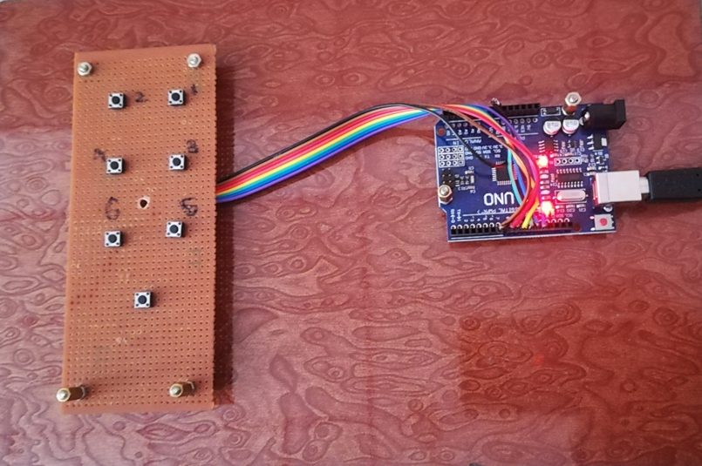
HARDWARE DESCRIPTION
The Braille keyboard is developed using an arduino UNO board .Six switches are used which act as the six dots in the Braille code .The input given through this keyboard is stored in the web service using JDBC connectivity Which is then read by the application and verified .

Slide 17
BRAILLE CODES -SAMPLE
a | ⠁ | 1
b | ⠃ | 12
c | ⠉ | 14

Slide 18
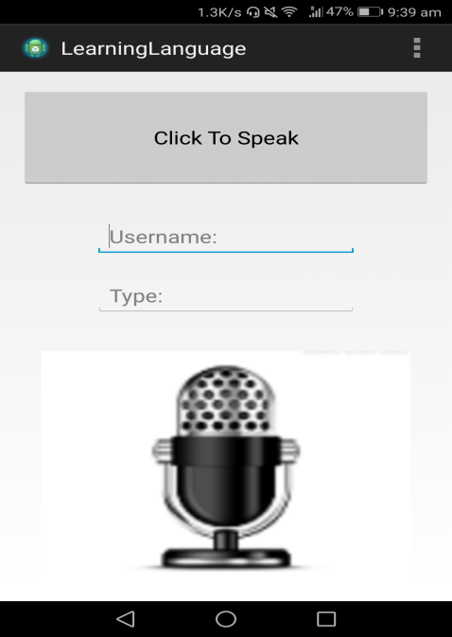
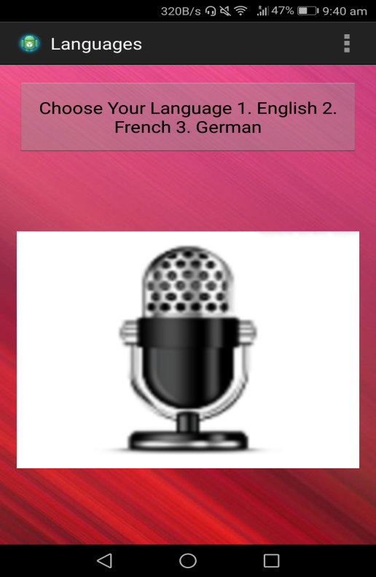
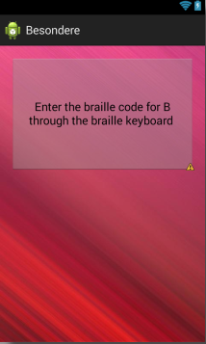
SNAPSHOTS
.

Slide 19
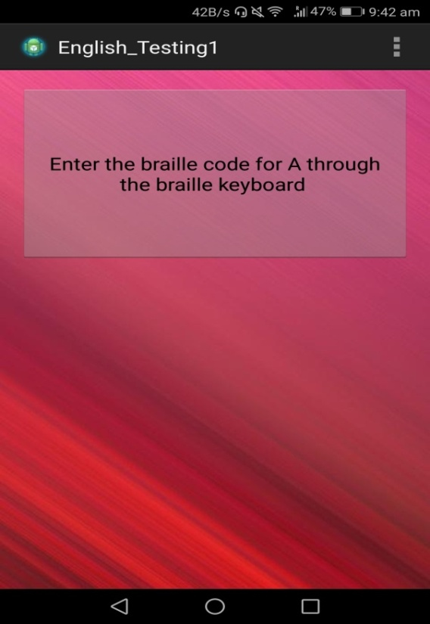
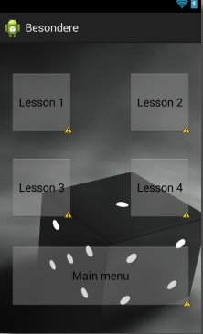
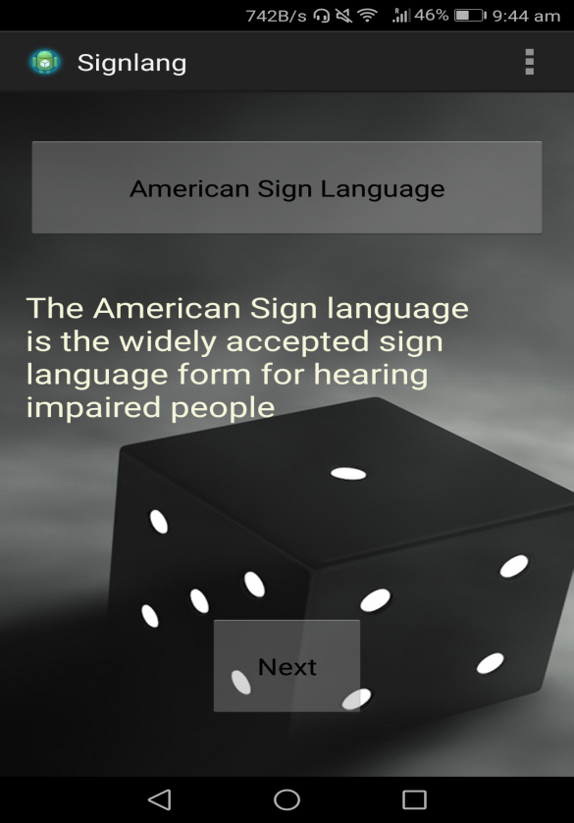
.
.

Slide 20
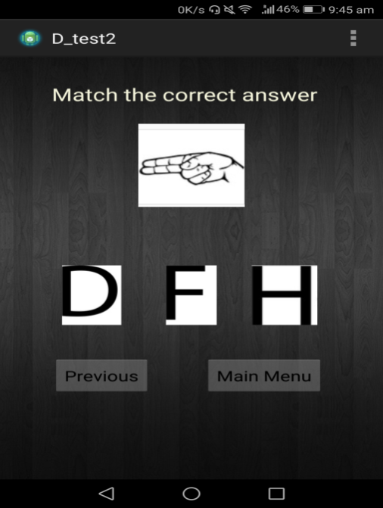
,
.

Slide 21
References
Adam Dąbrowski, Damian Huderek, Marcin Iwanowski, Piotr Kardyś, “A new android application for blind and visually impaired people”, IEEE Transaction on Computers, Poland 2016.
R. Guha, V. Gupta, V. Raghunathan, R. Srikant, “User modeling for a personal assistant”, The 8th WSDM International Conference, Shanghai 2015.
S. M. Kulkarni, Rupa N. Digole, ”Smart navigation system for visually impaired person”, International Journal of Advanced Research in Computer and Communication Engineering, India 2015.
Pooja Sharma, Shimi S. L, “Design and Development of Virtual Eye for the blind”, International Journal of Innovative Research in Electrical, Electronics, Instrumentation and Control Engineering, India 2015.

Slide 22
J. Hildenbrand, “What is Google TalkBack”, AndroidCentral.com, 2014.
Bairoju Vishwa Rupa Chary, B.Santosh Kumar, “Rescue system for visually impaired blind persons”, International Journal of Engineering Trends and Technology (IJETT), India 2014.
Harshad Girish Lele, Mrunmayi Mohan Modak, Viten Vilas Lonkar, Varun Vasant Marathe, “Electronis path guidance for visually impaired people”, The International Journal Of Engineering And Science (IJES), India 2013.
Abhishek Srivastava, Adhar Vashishth, Akshay Sharma, “An assistive reading system for visually impaired using OCR and TTS”, International Journal of Computer Applications, India 2014.
Amanda Hastings, Ravi Kuber, Matthew Tretter, “Determining the accessibility of mobile screen readers for blind users”, IASTED Conference on Human-Computer Interaction, Baltimore, USA 2012.
Shreyashi Narayan Sawant " Sign Language Recognition System to aid Deaf-dumb People Using PCA" International Journal of Computer Science & Engineering Technology (IJCSET)

Slide 23
Dalia Nashat, Abber Shoker, Reem Al-Ebilan “An Android application to aid uneducated deaf-dumb people” International Journal of Computer Science and Mobile Applications (IJCSMA)
Majzoob Kamal, Aldein Omer, Mohmed Sirelkhtem Adrees, Osama E. Sheta “Alternative Central Mobile Application Strategy to Deaf and Dumb Education in Third World Countries” International Journal of Soft Computing and Engineering (IJSCE)

